Slide 1
July is Disability Pride Month!

Slide 2
Hello!
My name is Kyra. I live on the lands of the Pinjarup people of the Noongar nation (south-west WA). I was born with Cerebral Palsy (CP), presenting as spastic quadriplegia. This means my CP affects my arms, legs, trunk, and neck, and I experience severe weakness and tightness of these muscles. I'm a full-time electric wheelchair user and require one-on-one support 24/7.
When I was 12, I did a presentation to my classmates about my CP. This was the beginning of my advocacy journey, and since then I have become passionate about raising awareness for disability and inclusion. I am a recent graduate of CPActive's Young Changemakers program, and I am really looking forward to continuing my advocacy by being a CPActive Champion! I am particularly interested in the topics of education, mental health, disability pride and intersectionality of identities.
Outside of my advocacy, I enjoy reading books and listening to music and podcasts. I will be starting my Bachelor of Community and Human Services at the end of this month, with the hopes of eventually becoming a student support officer or – you guessed it! – a disability advocate.
With July being Disability Pride Month, I wanted to share my story and talk about what disability pride means to me.
Please remember that this is my experience of disability. Just because I am proud of my identity as a disabled person doesn't mean you are expected to be. However you feel and experience your disability/disabilities is valid.

Slide 3
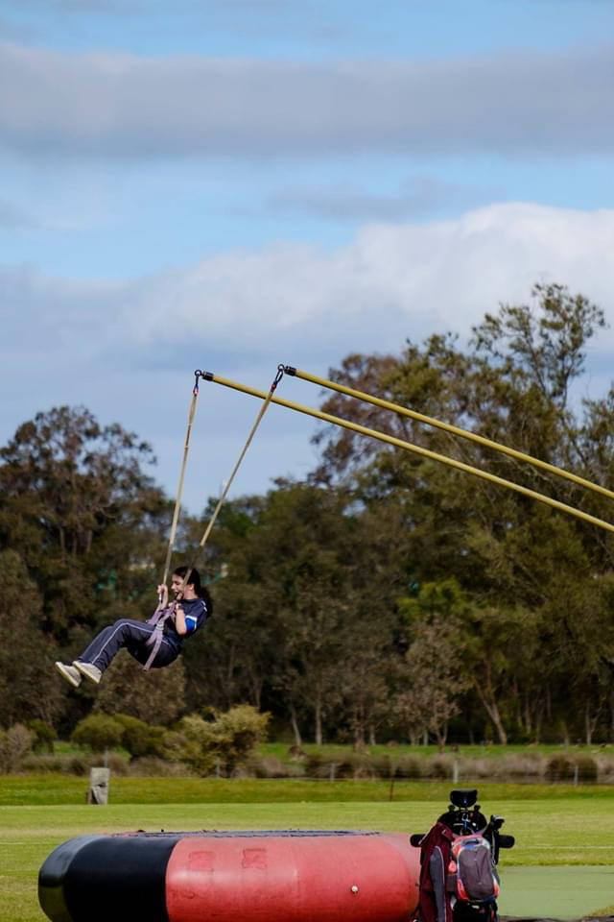
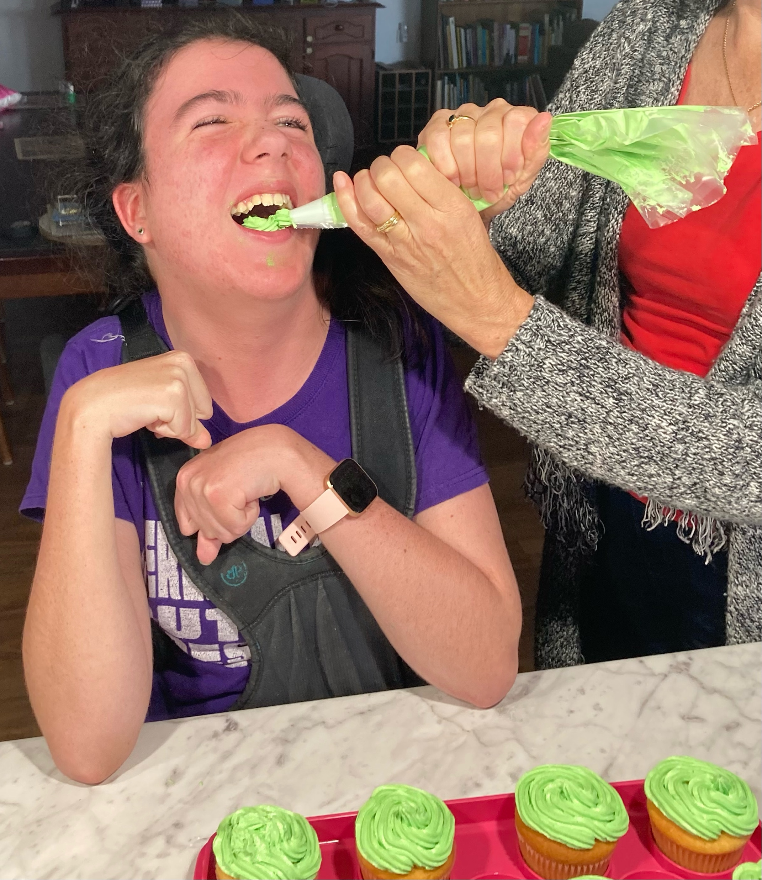
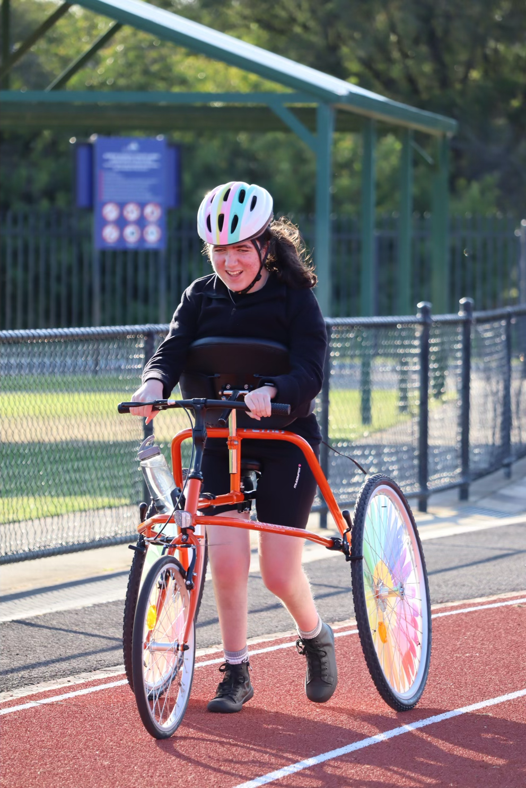
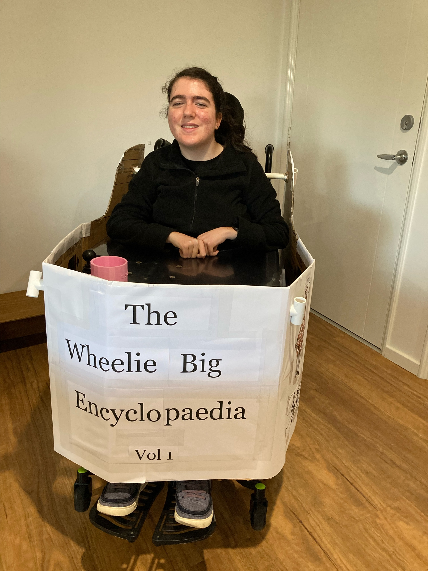
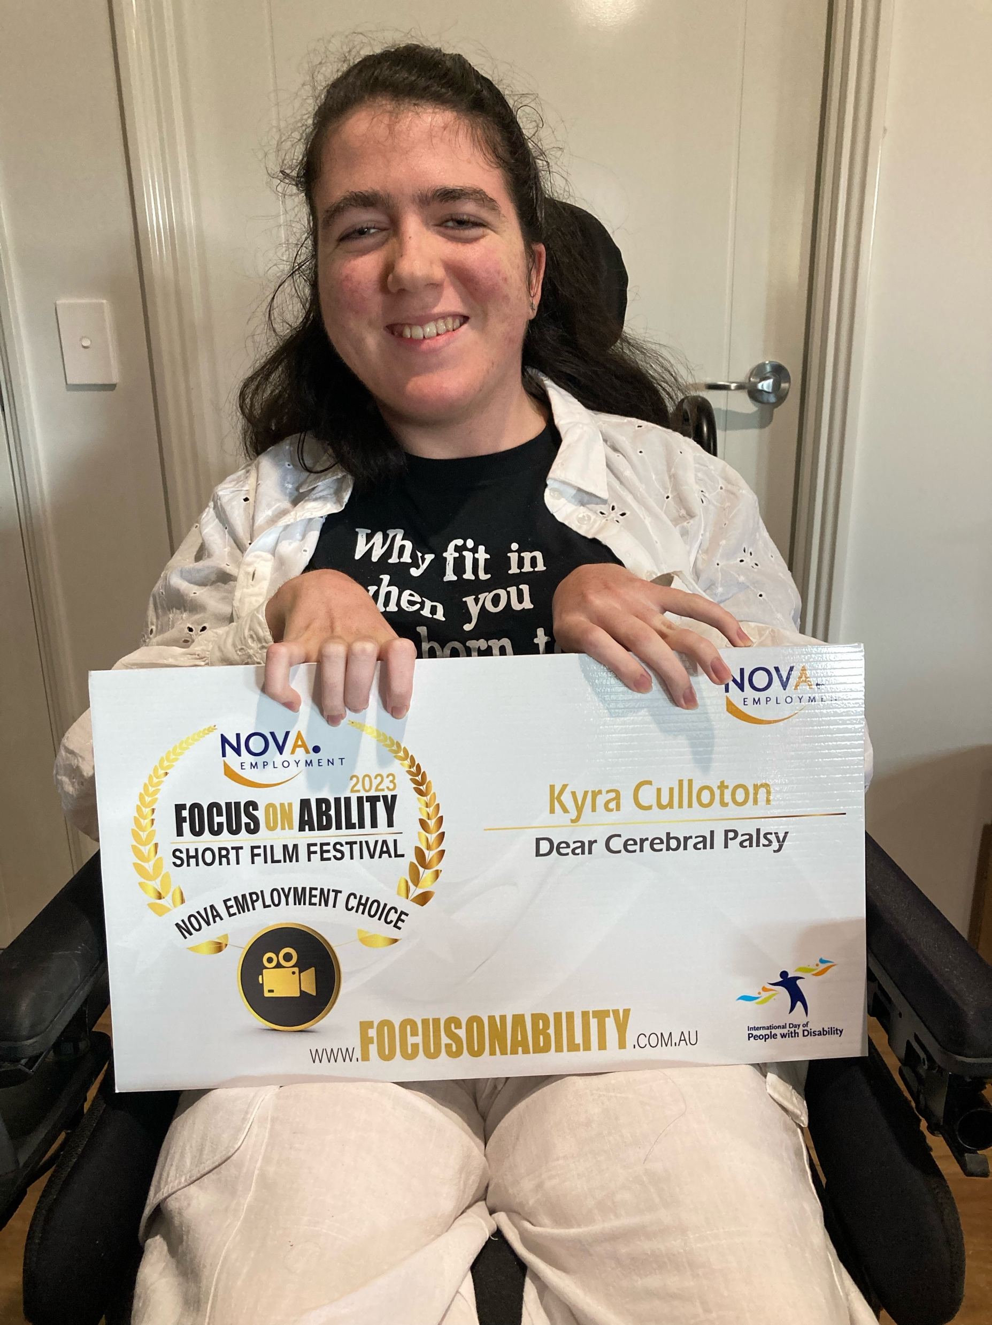
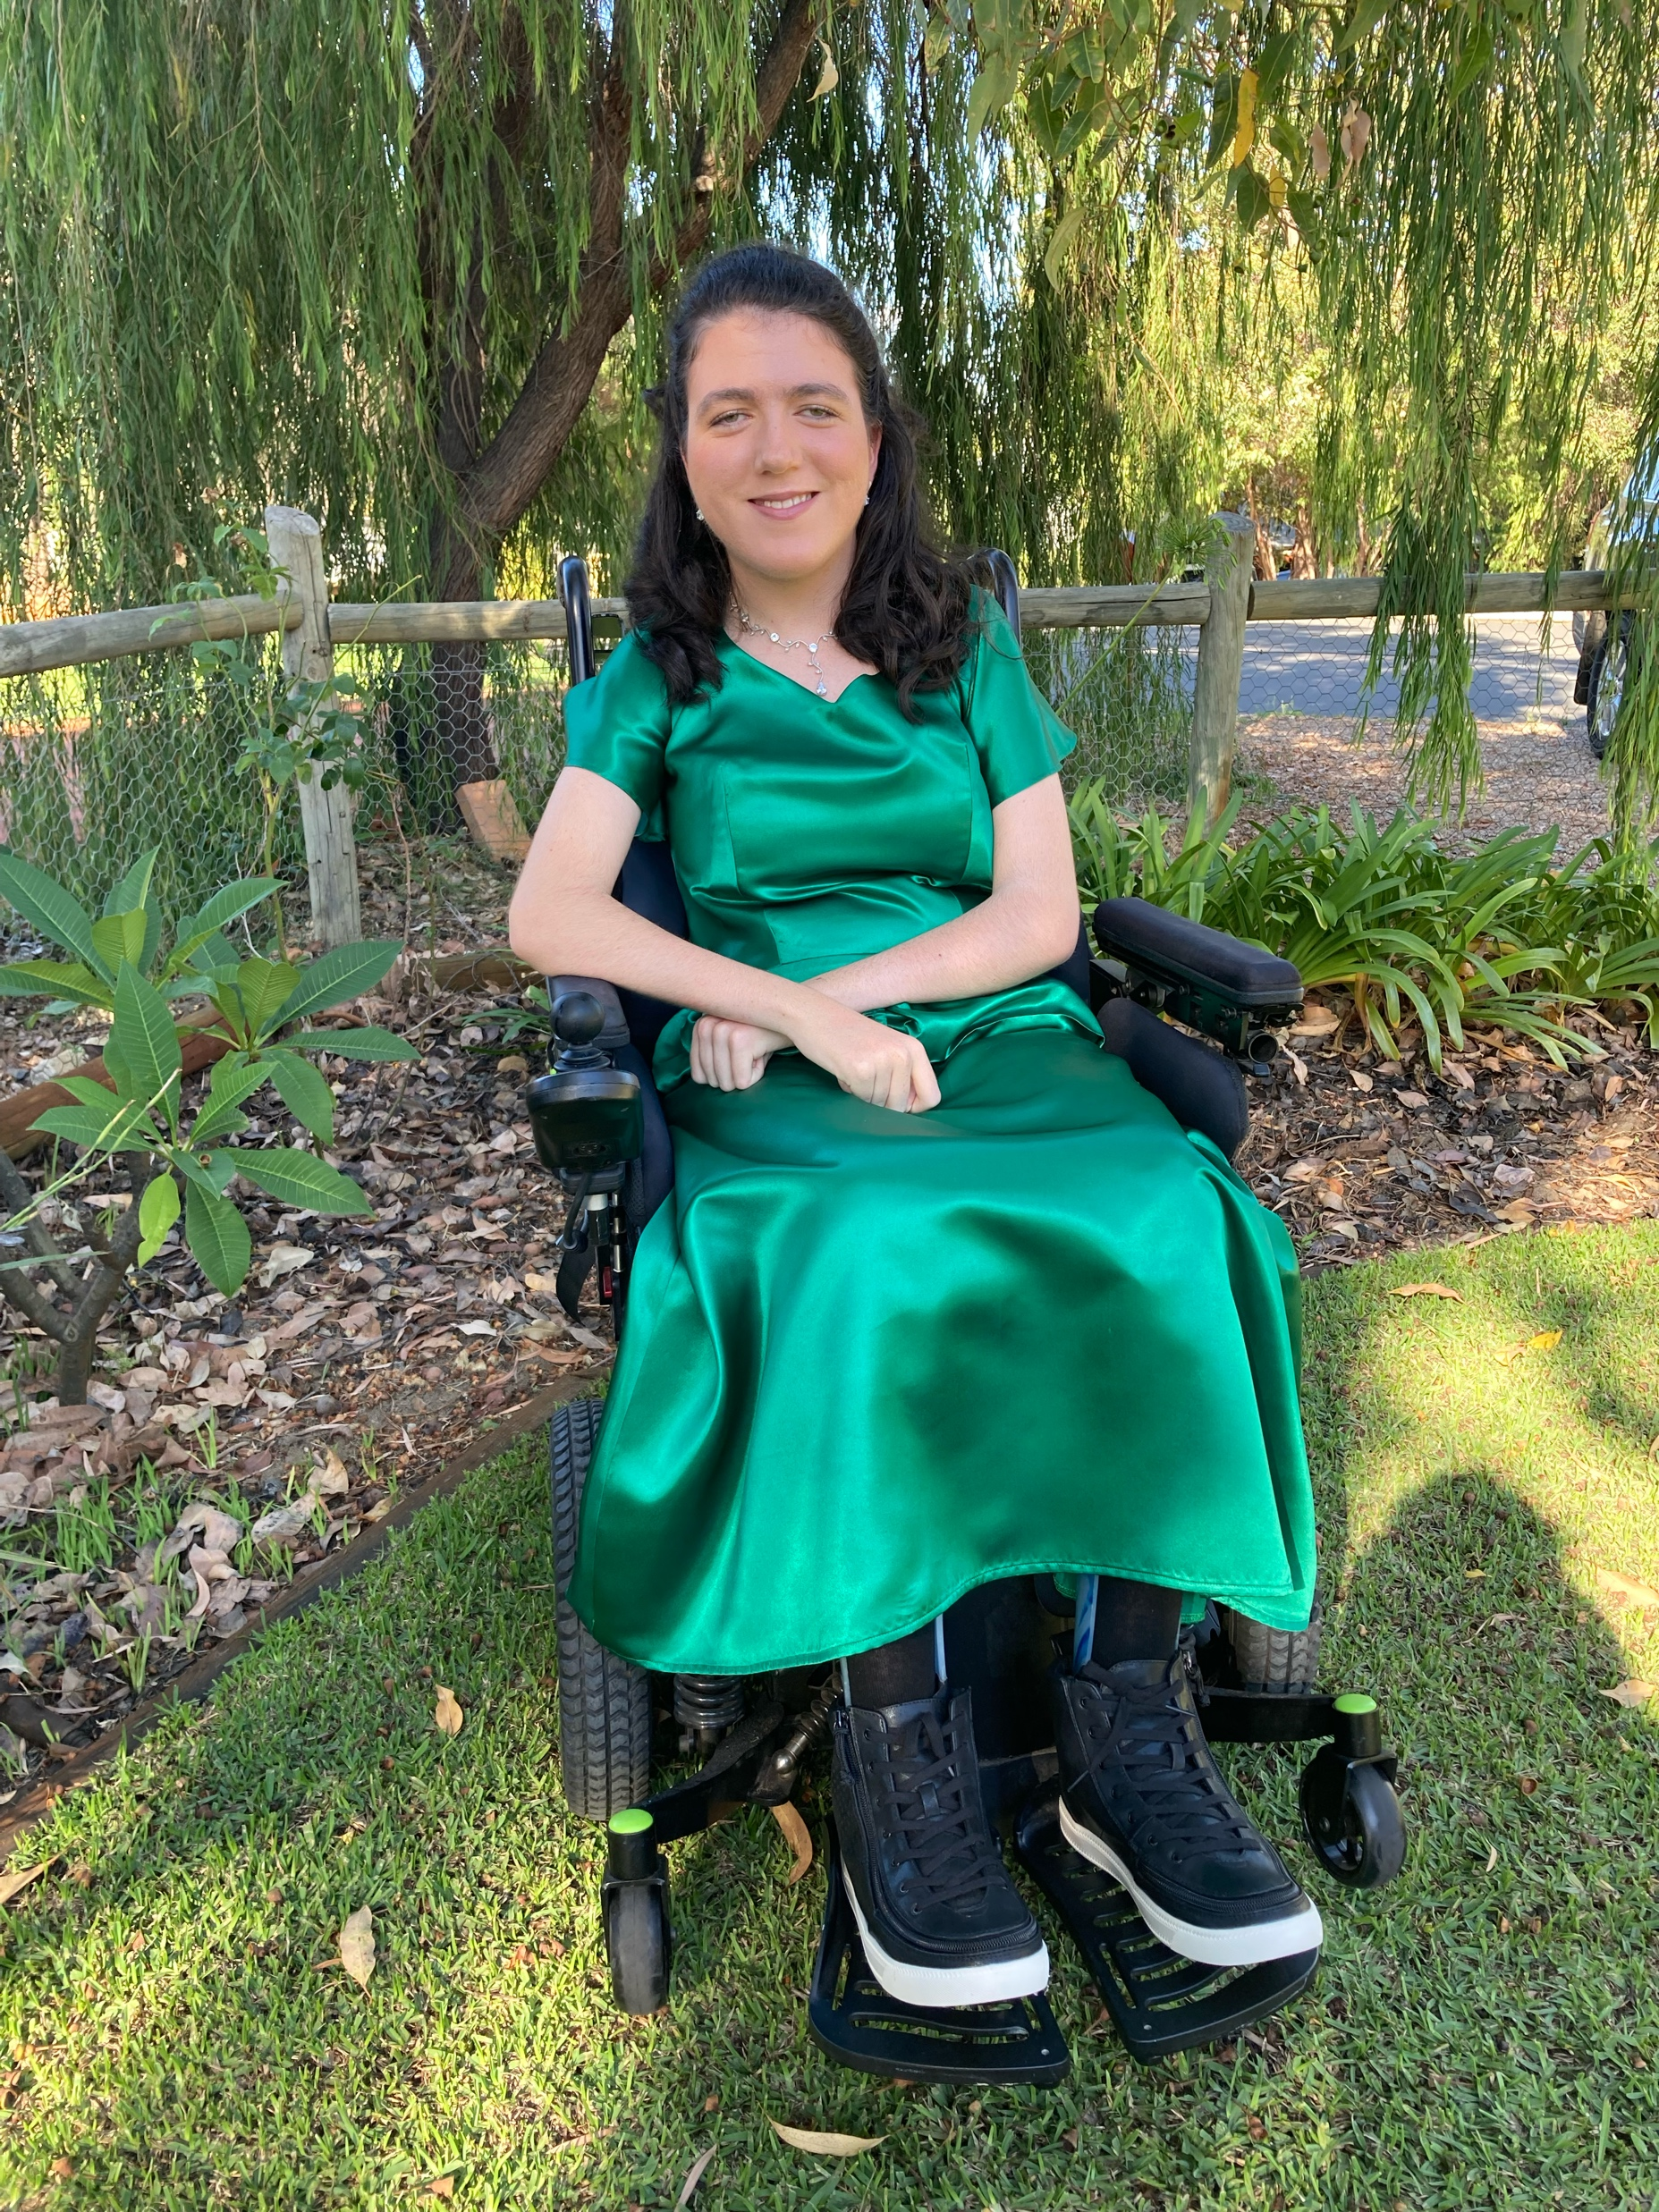
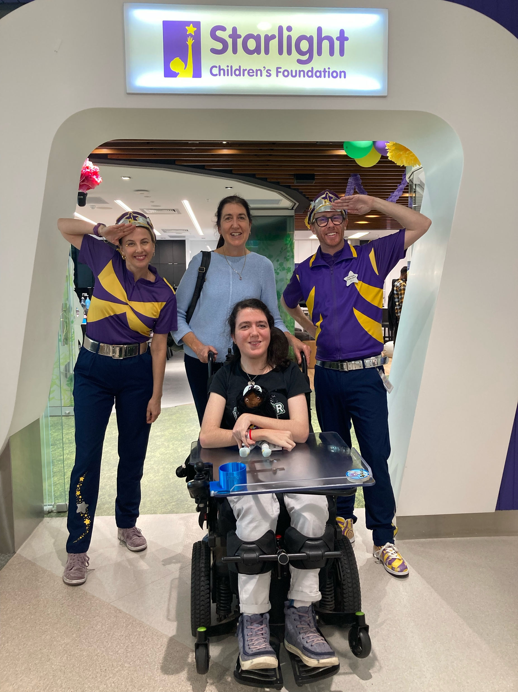
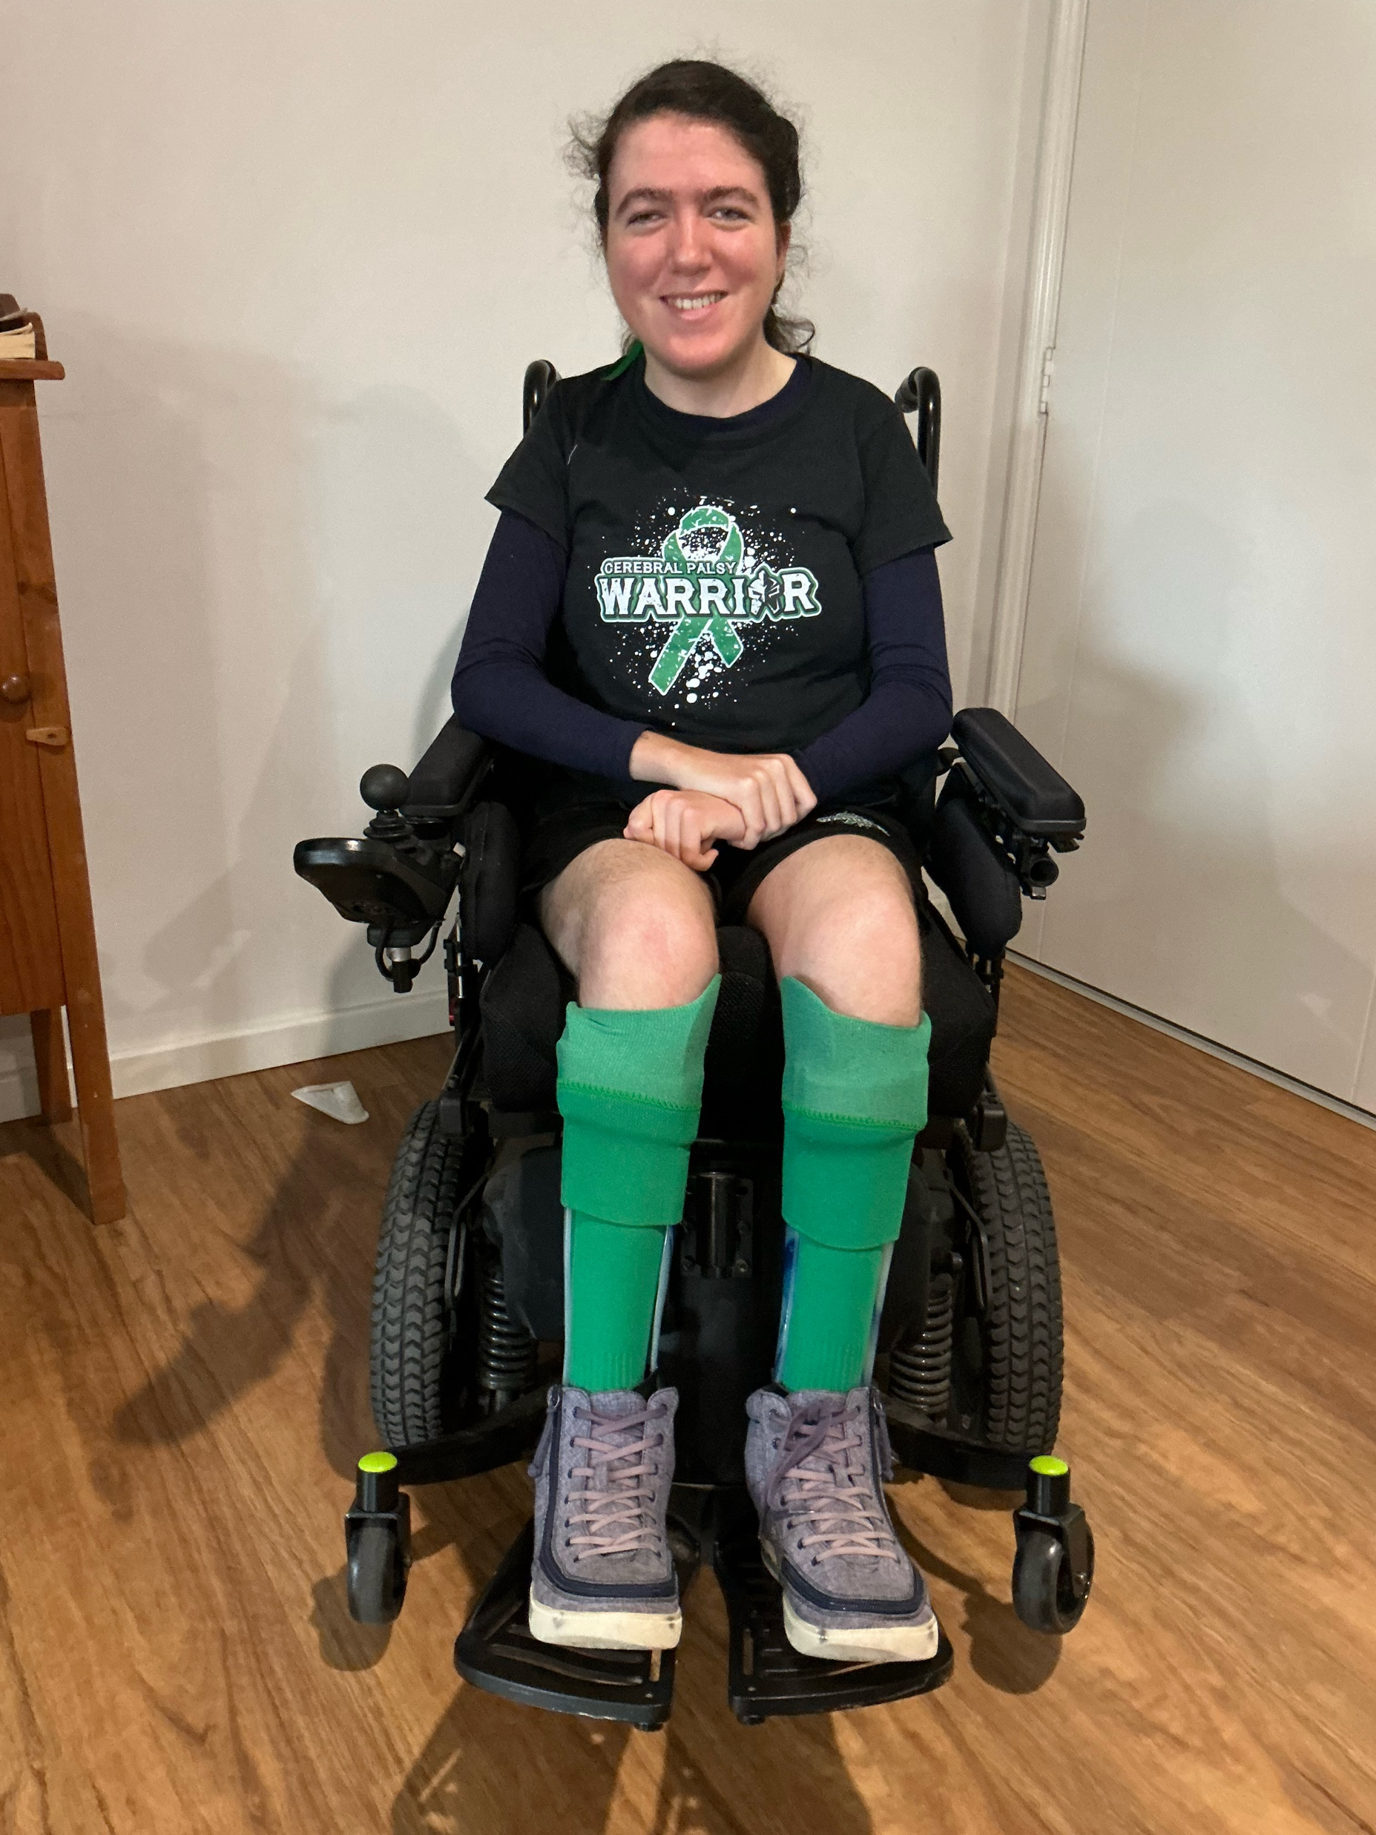
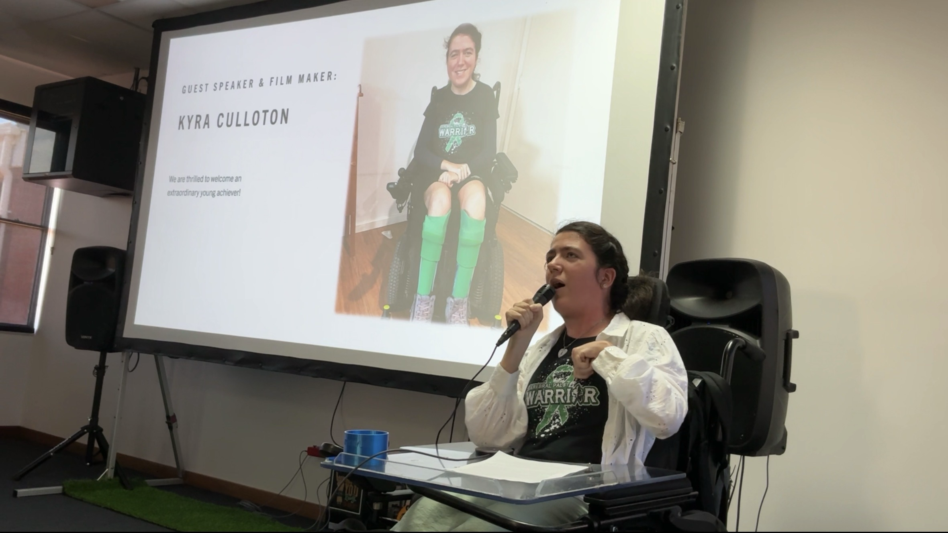
This is me!

Slide 4
Disability Pride – A Brief History Lesson:
Before I discuss my own experience of disability pride, I thought I would take you back in time and examine how the disability pride movement began.
July 26 1990: then US President George H.W. Bush signed the Americans with Disabilities Act (ADA) into law, to make illegal it for people to be discriminated against based on their disability.
July 2015: the first official disability pride celebration was held in New York to mark 25 years since the ADA. This was also the year that Disability Pride Month was officially established, and it has since expanded to many other countries.
Many unofficial disability pride celebrations occurred in between the above dates.

Slide 5


Disability Pride – the Flag:
The disability pride flag was designed by a lady living with Cerebral Palsy by the name of Ann Magill. The colours of the flag represent different types of disabilities, and the diagonal stripes symbolise disabled people 'cutting through' society's expectations of them. The meanings of the colours are as follows:
Red: physical disabilities
Yellow: neurodivergence (e.g. autism, ADHD, dyslexia, etc.)
White: invisible or undiagnosed disabilities
Blue: psychiatric disabilities and mental health conditions
Green: sensory disabilities (e.g. D/deaf/hard of hearing, blind/low vision, etc.)
Black/grey background: mourning and anger for disabled people who were/are victims of ablest violence and abuse.
The original disability pride flag was designed in 2019, and featured bright zigzag lines of the colours mentioned above. It was adapted in 2021 to make it more accessible for people who experienced visual processing triggers. The colours were dulled and also reordered to accommodate for individuals affected by red-green colour-blindness

Slide 6
Disability Pride – Acceptance and Resistance:
For me, disability pride is about accepting my identity and resisting society’s assumptions of me and the disabled community.
I fully accept my disability/limitations and share my experiences and perspective honestly. I am open about the support that I need, including assistive technology and other reasonable adjustments. Being accepting of my CP helps others realise that disability is not a negative thing and should be viewed as a normal part of human diversity. As part of my acceptance, I use both identity-first language (e.g. "I am a disabled person.") and person-first language (e.g. "I am a person with disability.") to describe myself. However, I tend to use identity-first language more often, as I believe this helps make people realise that disabled is not a bad word.
Remember, it is always important to ask people which wording they are most comfortable using, as we all have different preferences, and these deserve to be respected! And just because someone doesn't use identity-first language doesn't mean they are not proud of their identity as a disabled person.
To me, resistance is also a powerful way of expressing disability pride. Acts of resistance include showing up, challenging ableism/social norms, refusing to fit into a “box”, thriving despite people's (low) expectations, and being confident to be your authentic self.
Personally, I also show acceptance and resistance by reclaiming some previously ableist language with pride. For example, using the term “crip time” to describe the idea that it takes longer for me to complete all physical tasks because of my CP.

Slide 7
Disability Pride – Community, Celebration and Empowerment:
For me, community is about coming together and sharing experiences, but it is also about celebration and empowerment.
Talking to fellow disabled people who actually 'get it' is the most incredible feeling. They remind me that I'm not alone in my experience, and I love not having to ask (or apologise) for my access needs, as they are a given, instead of an afterthought, and we all know what it feels like when the 'little things' that make life easier for us are respected.
Celebrating the achievements of disabled people, as well as our strengths and unique perspectives that we bring, is important, as is to acknowledge that disability is a natural part of human diversity. Celebrating our disabled identities can be seen as a form of resistance and is one way of showing disability pride. We can also recognise the hard work of disabled activists/advocates that have come before us.
Empowering ourselves and the next generation of disabled people to be proud of their identities, be their authentic selves, and continue to advocate for their rights without feeling the need to apologise, is another way that community can foster a sense of disability pride.

Slide 8
Disability Pride – Advocacy:
For me, advocacy is about sharing my story, fighting for disabled people's rights, gaining allies, and educating society on how to be more inclusive. I demonstrate advocacy by posting about disability on my (private) social media account, participating in focus groups for research that aims to improve the lives of disabled people, and supporting disability organisations, such as CPActive and People with Disability Australia, by signing petitions. I also occasionally advocate by public speaking, expressing my experiences through creative writing, producing documentaries for the Focus on Ability Short Film Festival, and making content like this.
All forms of advocacy are valid, no matter how big or small!

Slide 9
Disability Pride – Intersectionality of Identities:
Intersectionality describes the way in which different aspects of a person's identity interact with each other to build their perspective of the world and shape how they may experience discrimination or privilege. Intersectionality is complex, and everyone’s identities are unique.
When I discuss intersectionality of my own identity, the main things I focus on are:
Disability: Cerebral Palsy – I don't think I need to elaborate; my CP is the whole reason why I am writing this!
Mental health: Generalised Anxiety Disorder – discussed in depth on the next slide.
Asexuality: I recently realised that I identify as asexual/queer. I am only just starting to talk about this publicly, and part of me still feels anxious to do so. I think this is because unlike my disability, my sexual orientation is not visible (and is also a more private topic). My asexuality is NOT a result of my disability or mental health challenges, but my experiences as a disabled person (i.e. needing someone to help me with all aspects of personal cares and activities of daily living) have played a part in influencing my sexual orientation, as I value body autonomy and privacy when I have the choice, and I don't feel the need or desire to connect with anyone in this way.
Obviously, like everyone, my identity is a lot more complex than the three aspects I have described, such as the fact that I am young, female, and I live in a regional area. I am still learning to be proud of all parts of my identity, and that's okay!
I love analysing how intersectionality of identities affects people's experiences, and I encourage you to reflect on how this applies to you!

Slide 10

Disability Pride and Mental Health – Part 1:
While I have been emphasising my disability pride, it does not mean that I don’t find being disabled hard. I also have Generalised Anxiety Disorder; a lot of my anxiety stems from growing up in a world that was not designed for people like me.
I have recently decided to start wearing the Hidden Disabilities Sunflower lanyard in certain situations to help others be more aware of my anxiety and the fact that I can easily become overwhelmed. While I personally do not consider my anxiety to be a 'disability', I recognise its intersectionality with my CP and the way that it affects me every day. I am hoping that I will learn to become proud of wearing the lanyard, rather than worrying that my anxiety is not 'bad enough' to warrant the support.
Continued on next slide.

Slide 11
Disability Pride and Mental Health – Part 2:
I thought I would share some situations that can trigger my anxiety, in case any of them resonate with you, and to remind you that you’re not alone:
Stigma and (internalised) ableism: due to the severity of my CP, people sometimes assume that I also have an intellectual disability. When I encounter people for the first time, they often (unintentionally) speak to me like I'm a toddler, which can trigger my anxiety, as I instantly start believing that they have low expectations of me, and that I will have to prove myself.
Navigating systems such as the National Disability Insurance Scheme (NDIS) and the education system: constantly having to prove the severity of my disability, in order to receive necessary supports.
Attachment challenges: I experience severe anxiety when I have to leave people who actually understand me and accept me for who I am (e.g. teachers, support workers and therapists). In some cases, I have experienced grief responses after leaving people.
Feeling like a burden to others.
Worrying that I won’t be able to assist someone in an emergency situation, if they need help.
Dealing with the uncertainty of how I will be supported as I get older (i.e. when my parents are unable to care for me).
I often feel vulnerable in crowded/busy situations, especially if they are loud. Due to my CP, I struggle to project my voice when there is a lot of background noise, and I also find it hard to hear other people, as my seated position compared to their standing, and the bulkiness of my wheelchair, puts extra distance between us. My anxiety in these situations is exacerbated when there is no obvious 'escape route' for when/if I get overwhelmed and need to leave quickly.

Slide 12
A Final Note:
Every aspect of my life is affected by my Cerebral Palsy, including my job choice, interests, values, and, of course, the way I complete all day-to-day activities. Without my CP, I would be an entirely different person. I am proud of my disability, and learning to be proud of my whole identity, and I wouldn’t change it for the world!
This Disability Pride Month (and all other months), I encourage you to actively engage with the disabled community. Inclusion is everyone’s responsibility, whether you are disabled or not. We can all work together to build a more inclusive future for disabled people, by listening to lived experience, challenging ableism, investing in the work/creations of disabled people and disability organisations (such as CPActive), and giving disabled people opportunities to access the support they need achieve their dreams.

Slide 13
Happy Disability Pride Month!

